Slide 1





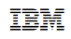









Operational Threat & Risk Information Sharing and Analytics
TEAM Threat

Slide 2

Introduction
Topic:
Operational threat and risk conceptual model and mappings standards process
Presenter:
Cory Casanave, Model Driven Solutions
Organization:
Object Management Group
www.omg.org
Resources:
www.threatrisk.org
Government Sponsor
Information Sharing Environment
www.ise.gov

Slide 3
Problem Space
There is a critical need to understand and mitigate threats and risks – to “connect the dots”.
The Landscape of threats is changing
Multiple attack vectors, cyber/physical and other
Advanced threats utilize multiple vulnerabilities
There are multiple communities addressing the same threats
Cyber/physical, emergency management, safety, defense, etc.
No comprehensive consistent semantic framework
Existing systems provide insular treatment of threat/risk relationships
Comprehensive system would allow system-of-systems interoperability (private/private, public/private)

Slide 4
What we need is an integrating framework that supports automated data mapping
Cyber
Crime
Terrorism
Critical Infrastructure
Natural
Disasters
Integrating Framework for Threats and Risks
Sharing & Analytics
Sharing & Analytics
Sharing & Analytics
Sharing & Analytics
Sharing & Analytics
An integrating framework that helps us deal with all aspects of a risk or incident
A federation of risk and threat information sharing and analytics capabilities

Slide 5



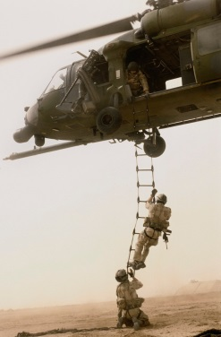



Example Information Flows
Suspicious Activity Report
NIEM
Incident
Arrest Report
STIX Incident
Tactical Response Unit
Fusion Center
Intelligence
Report
IT System Hardening
Manual Shutdown
Public CAP Warning

Slide 6
Primary classes of use cases
Transformation from one information sharing data format to another
Example: STIX Cyber Event to NIEM to a CAP Alert
Analytics of information federated from multiple sources
Examples:
Fusion center “connects the dots” between a stolen laptop (from NIEM) and a cyber incident (From STIX)
Bio hazard detected by automated instruments and collaborated by local health care professionals

Slide 7
Approach
Highlight O(N) vs. O(N^2)
Cyber
Terrorism
Construct a conceptual reference model informed by existing schema, research and best practices
This conceptual model is independent of specific data structures, technologies and terminologies
Define mapping models between the conceptual model and purpose/technology schema
Make both models sufficiently precise that they can drive automated bridging between any mapped schema
Cyber
Cyber
Cyber
Disasters
Map/Bridge
Map/Bridge
Map/Bridge
Conceptual Reference Model
Map/Bridge
Map/Bridge
Criminal
Cyber
Criminal
Infrastructure

Slide 8
Precepts
The purpose/organizational/technology specific schema will not (should not) go away
A “one size fits all” solution will not work
There will be no one technology
There will be no one terminology or language
There will be no one data structure for threats and risks
Our focus is federation
Understanding the concepts behind the schema
Mapping them to/through a common conceptual model
Enabling interoperability by bridging between the specific schema
Supporting integration and coordination of mitigation and response capabilities

Slide 9

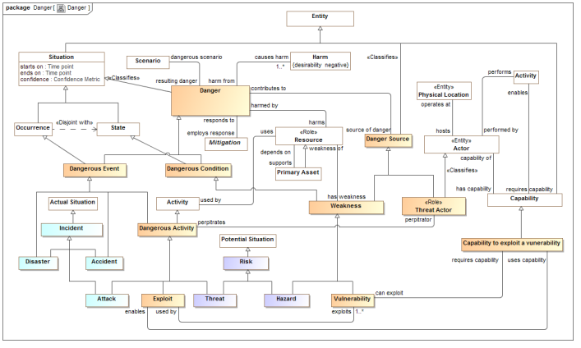
Conceptual Model Inputs
Conceptual Reference Model
NIEM
(General)
KDM
(Risk)
NIST Framework
STIX
(Cyber)
OGC
(Geo)
EDXL
(Emergency)
FIBO (Finance)
SEI
(Safety)
CAL OES
(Health)
MAP
ISO
(Risk)
ISO
(Units)
RMS
(Custody)
STIX, NIEM, EDXL, Others
There is still more to do to fully integrate the above and we anticipate more inputs and use cases

Slide 10
Realization
This “conceptual reference model” orientation is really quite different from defining a model or ontology for a specific purpose or application!

Slide 11
Mappings included
STIX – Structured Threat Information Exchange, for Cyber threat information. (Moving to Oasis “CTI”)
NIEM – National Information Exchange Model – For justice, public safety and other domains.
Risk Model – A concrete risk model for data interchange is included and mapped as none currently exists as a standard.
NIST 800-53 – Security and Privacy Controls for information systems. This is not a data mapping but shows how the concepts support the controls.
Note: More mappings are anticipated as the initiative unfolds. Some may be published but not standardized.

Slide 12
Ontological Challenges
“Temporal aspects” of all relationships and situations is important. Not understanding these temporal aspects could result in error.
The threat/risk model incorporates temporal aspects into the core of the ontology and language. All situations and relationships are temporal. In OWL and other FOL based languages this requires reification.
Provenance of every “fact” is crucial to trust.
Due to the reification, metadata can be attached to every assertion.
Different communities and systems use different ways to represent the same thing or occurrence in the world.
The threat/risk model is a model of a real (or possible) world, not data. These concepts provide a pivot point between different data representations that are then mapped.
What something is and the roles it takes in various situation gets conflated.
“Role” is a “first class” concept – something or someone may play different roles at the same or different times
The world has time and context – not “first order”
We represent the real-world concepts. What and how to reason is derived by mappings.
Various levels of detail and precision for different stakeholders (expert view is not intuitive)
We try for a happy medium, where the expert concepts are simplified

Slide 13
Pivoting Through a Reference Model
“Source”
Data
Representation
Data representations (Schema & Instances)
Model data for a purpose using a technology
“Instances” are data structures (e.g. SQL tables or XML documents) – “facts” about the things in the world from some perspective
Conceptual Reference Models
A conception of the world by a group of stakeholders – less purpose specific
“Instances” are things in the world – so can’t be in models
Using abstraction, we can have multiple representations of facts about the world in different data structures and technologies
Rules define how domain concepts can be represented in a particular form – rules can be simple and generic or heavyweight and specific, depending on the representation.
“Target”
Data
Representation
Represent
Rules
Conceptual Domain Models
(Models of the world)

Slide 14
Kinds of models
Conceptual Reference Models
Defines the terms and concepts of the threat & risk domain as a semantic model. Conceptual models can also be transformed to ontologies.
Data models
Represents specific logical or physical data schema for a specific purpose – more concrete and structured.
Data models are a direct representation of some kind of schema, e.g. XML Schema, SQL Schema or RDF Schema.
Mappings
Mappings relate a data model to one or more conceptual models to provide for automated transformation and federation of information in these deferent formats.
The conceptual models become the “pivot point” between multiple data representations of the same and related concepts.

Slide 15
Conceptual Model Layering
Operational threat situational awareness and response
Operational risk evaluation and mediation
Cross-risk/threat – specific “wide and shallow” risk and threat concepts/ E.G. Risk, threat, danger, consequence
Generic Library – Provides concepts and links across multiple viewpoints, not just threat/risk. E.G. Person, Objective
Kernel– Foundational concepts for modeling anything: Entities, Roles, Relations, Types, Information, Rules, Identity, Etc…
Subset of the model from SIMF

Slide 16
Conceptual Model Packages
Generic Concepts
Abilities
Actors
Assessment
Contact Information
Containment
Control
Credentials
Cyber
Enterprise
Entities
Events and Activities
Identifiers
Intent
Location
Objectives
Observations
Generic Concepts
Organizations
Patterns
Persons
Physical Entities
Places
Policies
Predictions
Processes
Quantities and Units
Resources
Responsible Performers
Rules
Situations
Time and Temporality
Vendors and Producers
Threat and Risk Specific Concepts
Campaigns
Danger
Danger Categories
Danger Sources
Incidents and Failures
Indicators
Risk
Risk Treatment
Threat Actors
Undesirable Situations
Vulnerabilities
Weapons

Slide 17
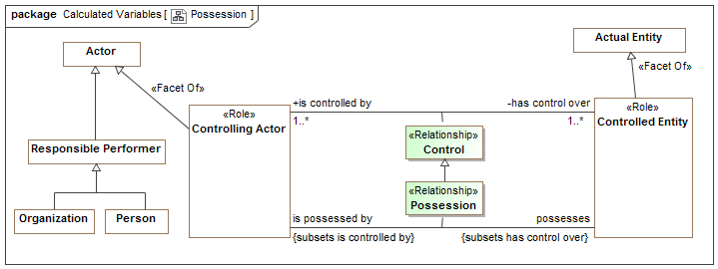
Example of Modeling Style
Control Possession relationships are “first class” – have a timeframe, can be part of cause and effect, etc.
“Controlling Actor” is a role – people and organizations can play this role
Both entity classes and relationships form hierarchies
There are multiple ways “data structures” could be arranged to represent this information or a subset of it – that is the subject of mappings.

Slide 18
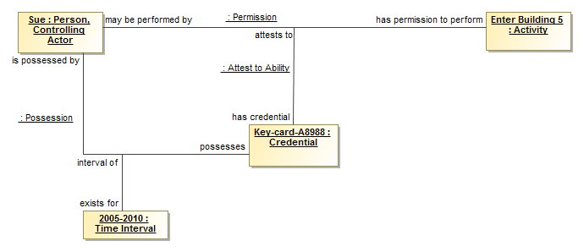
Example Instances
In the time interval from 2005-2010 Sue <possesses>“Key-card-A8988” that <attests to> the permission: Sue <has permission to perform> “Enter Building 5”.
Note: Note the best notation; this is intended to validate the model using UML.

Slide 19
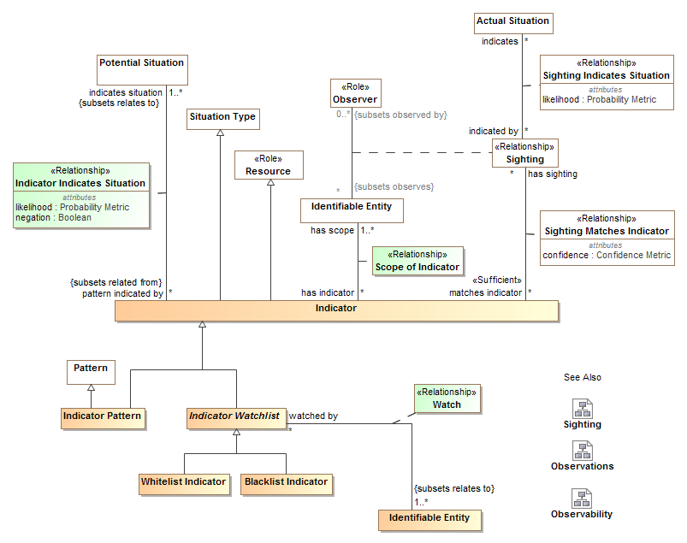
Example of more threat-specific module

Slide 20
Model/Ontology/Vocabulary Representation
Operational Threat/Risk uses the in-progress “Semantic Information Modeling for Federation” (SIMF) specification, being developed in the OMG.
SIMF defines a foundational semantic conceptual model for the modeling language as well as a UML (Unified Modeling Language) profile.
The UML Profile is what has been shown, using the “Cameo Concept Modeler” from Nomagic.
Based on the (draft) specification, CCM is able to generate OWL for the threat/risk model. Other implementation technologies could be generated as well.

Slide 21
Data Mappings
STIX & NIEM

Slide 22
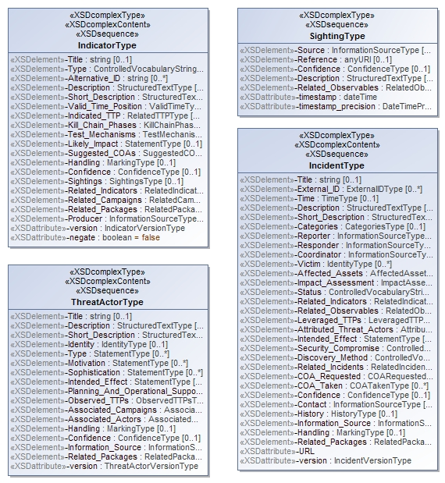
Representing the STIX physical model
<xs:complexContent>
<xs:extension base="stixCommon:IndicatorBaseType">
<xs:sequence>
<xs:element name="Title" type="xs:string" minOccurs="0">
<xs:annotation>
<xs:documentation>The Title field provides a simple title for this Indicator.</xs:documentation>
</xs:annotation>
</xs:element>
<xs:element name="Type" type="stixCommon:ControlledVocabularyStringType" minOccurs="0" maxOccurs="unbounded">
<xs:annotation>
<xs:documentation>Specifies the type or types for this Indicator.</xs:documentation>
<xs:documentation>This field is implemented through the xsi:type controlled vocabulary extension mechanism. The default vocabulary type is IndicatorTypeVocabularyType in the http://stix.mitre.org/default_vocabularies-1 namespace. This type is defined in the stix_default_vocabularies.xsd file or at the URL http://stix.mitre.org/XMLSchema/default_vocabularies/1.1.1/stix_default_vocabularies.xsd.</xs:documentation>
<xs:documentation>Users may also define their own vocabulary using the type extension mechanism, specify a vocabulary name and reference using the attributes, or simply use this as a string field.</xs:documentation>
</xs:annotation>
</xs:element>
<xs:element name="Alternative_ID" type="xs:string" minOccurs="0" maxOccurs="unbounded">
<xs:annotation>
<xs:documentation>Specifies an alternative identifier (or alias) for the cyber threat Indicator.</
XML Schema is reverse engineered into UML. Next version of STIX will have native UML model.

Slide 23
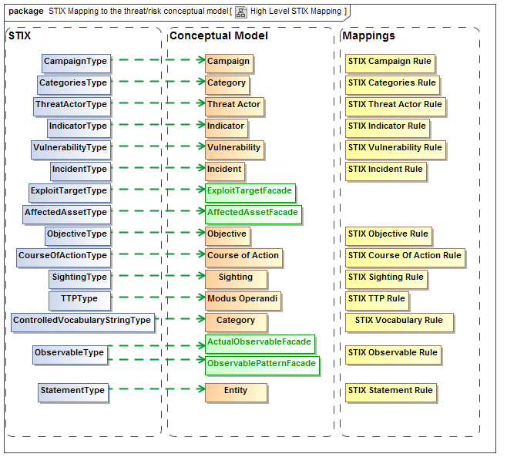
XML Element represents concept
Mapping
Rule
Represents
STIX XSD
Concepts
Green line is “Represents”
Rules specify mapping details

Slide 24
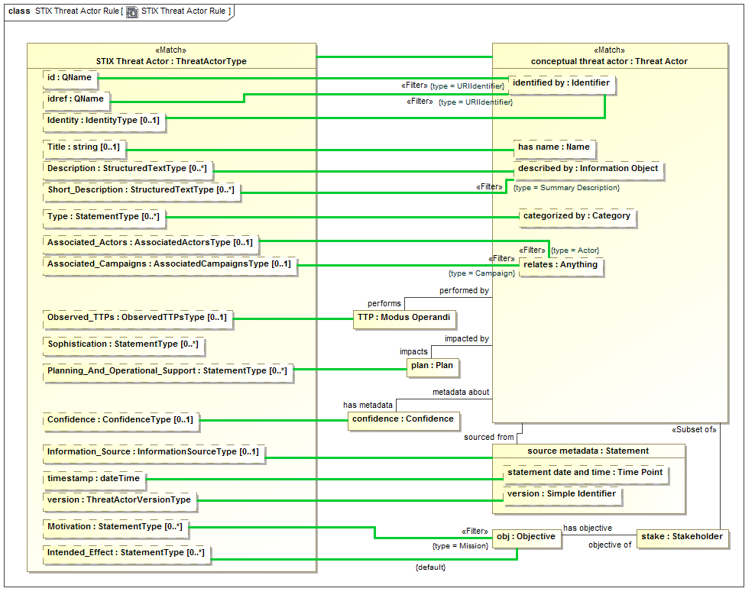

Slide 25
Example STIX source data
<stix:Incident id="example:incident-fd56fb34-af59-47b3-95cf-7baaaa53fe93" timestamp="2014-08-28T16:42:52.859547+00:00" xsi:type='incident:IncidentType' version="1.1.1">
<incident:Title>Breach of Canary Corp</incident:Title>
<incident:Time>
<incident:Incident_Discovery precision="second">2013-01-13T00:00:00</incident:Incident_Discovery>
</incident:Time>
<incident:Description>Intrusion into enterprise network</incident:Description>
<incident:Reporter>
<stixCommon:Description>The person who reported it</stixCommon:Description>
<stixCommon:Identity id="example:Identity-5db269cf-e603-4df9-ae8c-51ff295abfaa">
<stixCommon:Name>Sample Investigations, LLC</stixCommon:Name>
</stixCommon:Identity>
<stixCommon:Time>
<cyboxCommon:Produced_Time>2014-03-11T00:00:00</cyboxCommon:Produced_Time>
</stixCommon:Time>
</incident:Reporter>
<incident:Victim id="example:Identity-c85082f3-bc04-43c8-a000-e0c1d0f2c045">
<stixCommon:Name>Canary Corp</stixCommon:Name>
</incident:Victim>
<incident:Impact_Assessment>
<incident:Effects>
<incident:Effect xsi:type="stixVocabs:IncidentEffectVocab-1.0">Financial Loss</incident:Effect>
</incident:Effects>
</incident:Impact_Assessment>
<incident:Confidence timestamp="2014-08-28T16:42:52.859570+00:00">
<stixCommon:Value xsi:type="stixVocabs:HighMediumLowVocab-1.0">High</stixCommon:Value>
</incident:Confidence>
</stix:Incident>

Slide 26
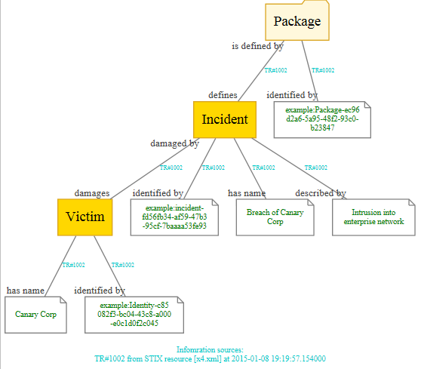
Example of mapped data graph
Provenance

Slide 27
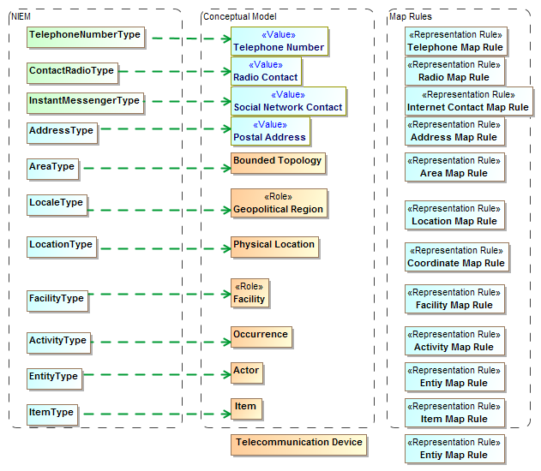
NIEM Mapping summary (1)

Slide 28
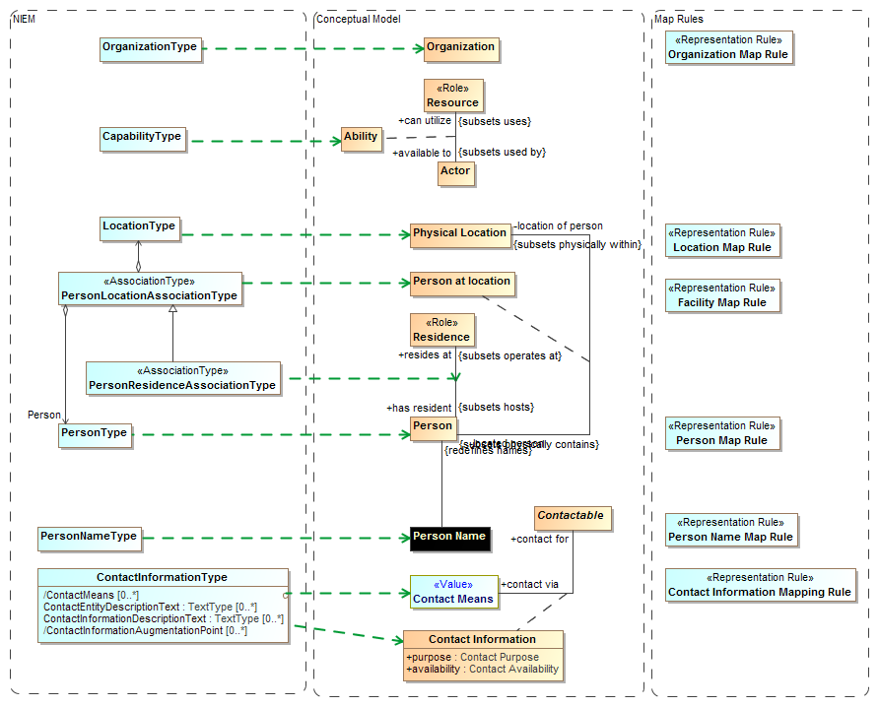

Slide 29
Result of mapping
Two-way semantic “pivot” through conceptual reference models

Slide 30
The Process
Building a community and standards to protect against threats and risks

Slide 31
Open Community Process
Our goal is to create and encourage
Open standards for threat and risk information sharing
A community of information providers, consumers, analysts and products
The standards process is organized under the “Object Management Group” (www.omg.org)
The community “home” is www.threatrisk.org
While not required by OMG process, the submission team publishes draft specifications to invite comment, engagement, community building and implementation. OMG Membership is encouraged but not required.
Stakeholders may contribute to the specification.
We are also exploring options for open source implementations

Slide 32

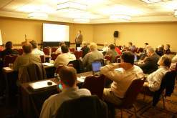
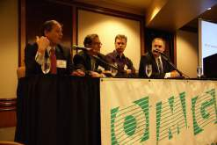
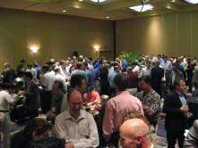
Who Is OMG?
Object Management Group (OMG):
Founded in 1989
More than 470 member companies
The largest and longest standing not-for-profit, open-membership consortium which develops and maintains computer industry specifications.
Continuously evolving to remain current while retaining a position of thought leadership.
Notes:
Which are membership requests, submits, develops and maintains To help achieve the objectives of Reusability, interoperability and portability
These standards are requested, submitted, adopted and maintained by the membership.

Slide 33




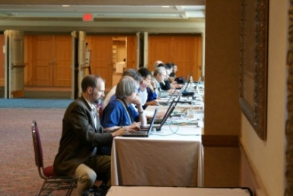
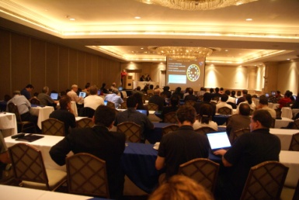
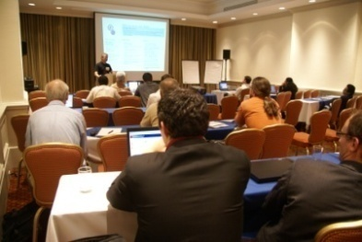
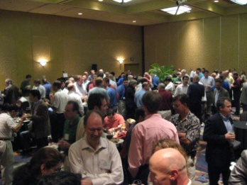
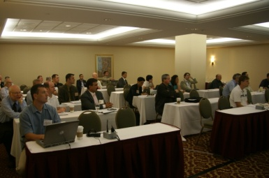
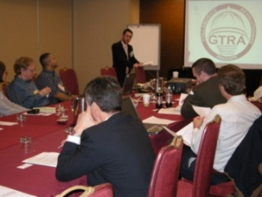
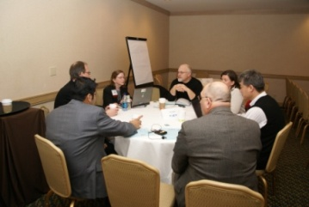
Developing Standards
Standards are developed using OMG’s mature, worldwide, open development process. With over 20 years of standards work, OMG’s one-organization, one-vote policy ensures that every vendor and end-user, large and small, has an effective voice in the process.
Notes:
33

Slide 34






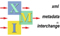
OMG’s Best-Known Successes
Common Object Request Broker Architecture
CORBA® remains the only language- and platform-neutral interoperability standard
Unified Modeling Language
UML® remains the world’s only standardized modeling language
Business Process Modeling Notation
BPMNTM provides businesses with the capability of understanding their internal business procedures
Common Warehouse Metamodel
CWMTM, the integration of the last two data warehousing initiatives
Meta-Object Facility
MOFTM, the repository standard
XML Metadata Interchange
XMI®, the XML-UML standard

Slide 35
Submitters and Contributors (Thus Far)
Information Sharing Environment (ise.gov)
Demandware
U.S. Air force
U.S. Defense Security Services
California Public Safety (http://www.Caloes.ca.gov)
U.S. National Information Sharing Model PMO (https://www.niem.gov/)
Duke Energy
NSA/UCDMO
NIST
INCOSE
Integrated Networking Technologies, Inc.
Tibco Software Inc.
Hitachi
NC4
Others pending approval
Model Driven Solutions division of Data Access Technologies
KDM Analytics, Inc.
International Business Machines, Inc.
RSA, The Security Division of EMC
Lockheed Martin, Inc.
Oracle Corporation
Fujitsu
Team Threat

Slide 36
Questions and Invitation
Join us! Help us: Define the standard, validate it with your use cases, merge with other models, implement it, fund it

